Slide 1
Final Project Presentation ECE311 Hardware design
Ahmad Malik

Slide 2
VGA Interface
This project focused on designing a VGA protocol that supports 4bit colors using the AXI4 Processor.
It will support a 1980x80 Resolution. Assuming we display at 60 fps. This would require a throughput of 1920*1080*60*3 = 373.248 Megabytes per second.

Slide 3
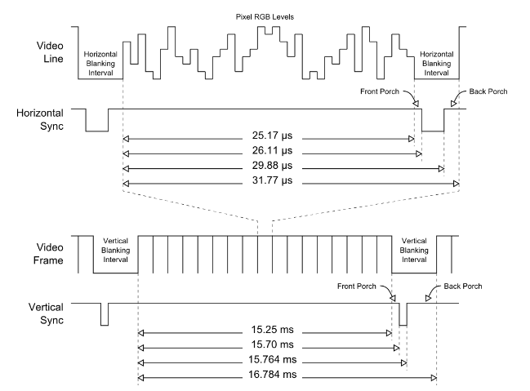
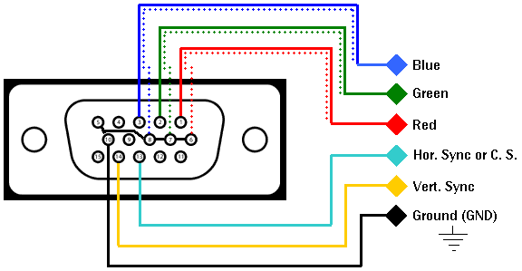
Synchronization
To synchronize the video and clock signals, the VGA interface uses horizontal and vertical synchronization (HSYNC and VSYNC) signals. The HSYNC signal is used to synchronize the display of each horizontal line of pixels, while the VSYNC signal is used to synchronize the display of each vertical line of pixels.

Slide 4
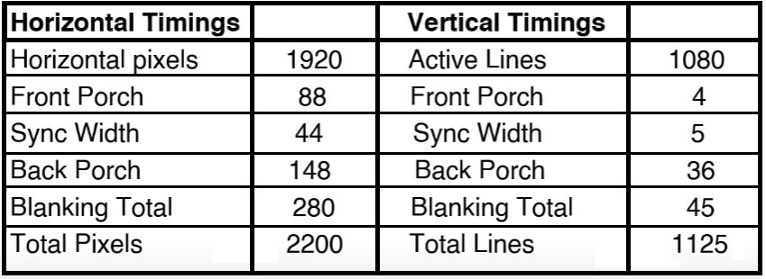
Pixel Clock
The diagram shows time intervals such as back porch is a period of time in the horizontal blanking interval where the video signal is not active. The horizontal blanking interval is a period of time in each video frame where the video signal is not active, and is used to allow the display to refresh and prepare for the next frame. vertical blanking interval is a similar period of time that occurs between video frames, and is used for the same purpose.

Slide 5
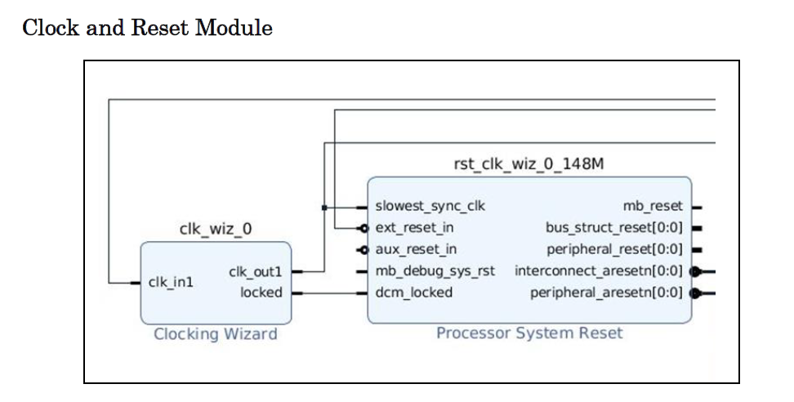
Vivado Implementation
Here we can see the clocking wizard generates the required clock of 148.5MHz and the Processor System Reset controls the synchronous reset.

Slide 6
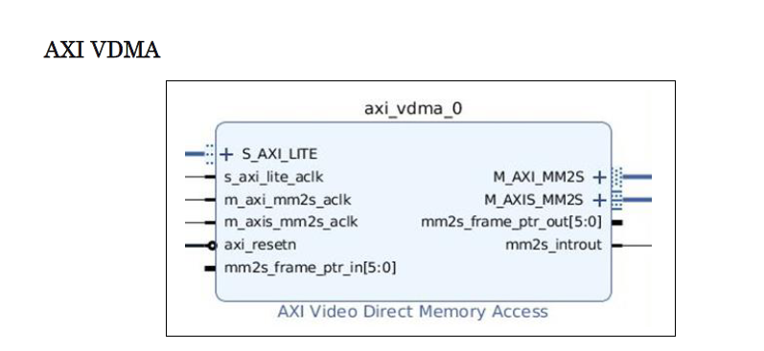
Vivado Implementation
The AXI VDMA is an IP core that allows for the transfer of video data from external memory to an AXI4 Stream interface. It is used to stream video data from a frame buffer in external memory, such as DDR memory on the ZedBoard, to an AXI4 Stream interface for processing or display.

Slide 7
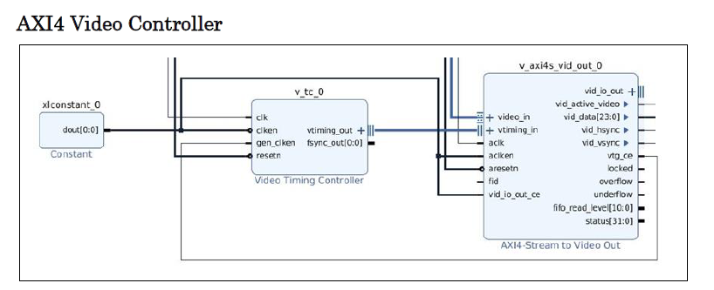
Vivado Implementation
The AXI4 and Video Timing Controller work together to display video data. The AXI4 Stream interface receives digital video data and the video timing controller provides timing information, such as horizontal and vertical synchronization signals. The AXI4 Stream interface combines the video data with the synchronization signals and outputs a resulting analog video signal to a display using a D/A converter.

Slide 8
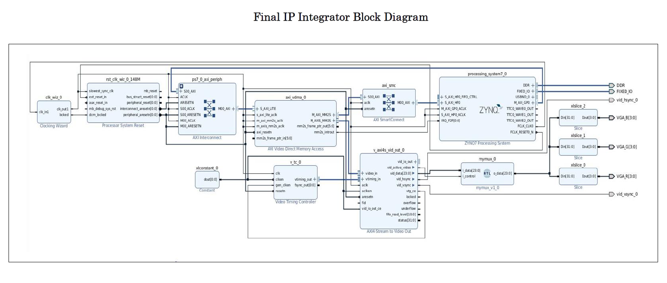
Vivado Implementation

Slide 9
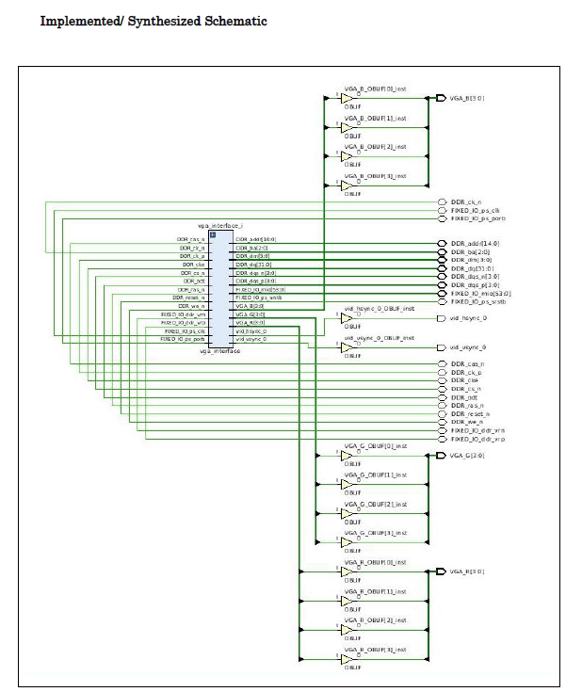
Vivado Implementation

Slide 10
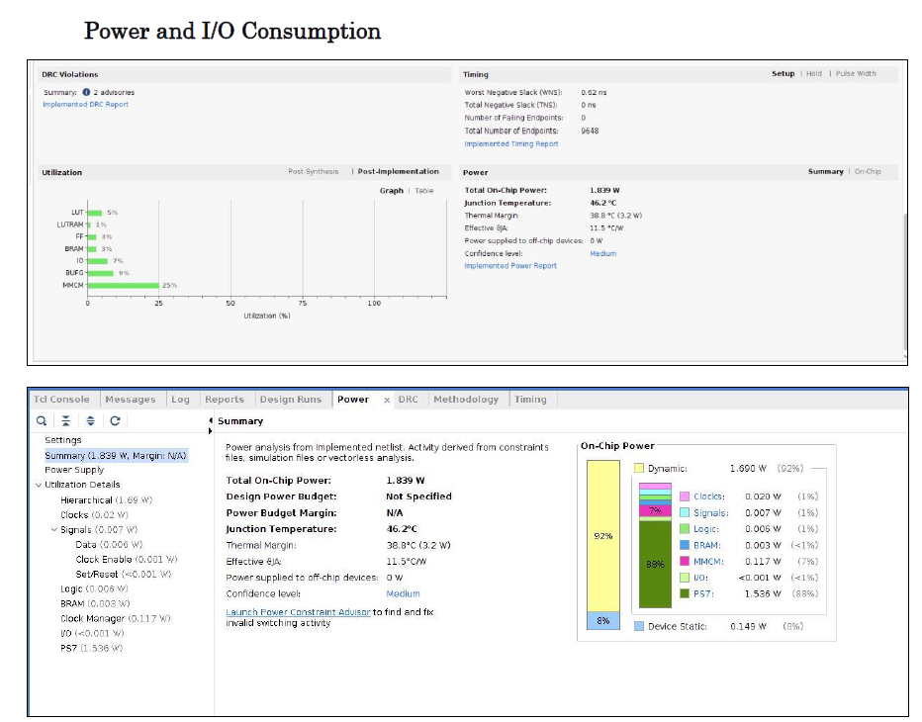
Vivado Implementation

Slide 11
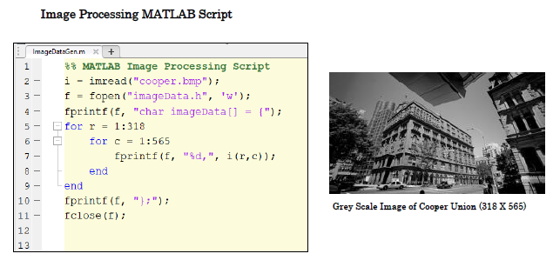
Vivado Implementation
A simple MATLAB Script was used process an image pixel by pixel, saving each pixel as an 8bit decimal value into a one dimensional character array called “imageData[ ]”. From there, we used SDK to process this array and output it 24 bits at a time to the Zedboard using a C script (credit to code provided by Vipin Kizheppatt).

Slide 12
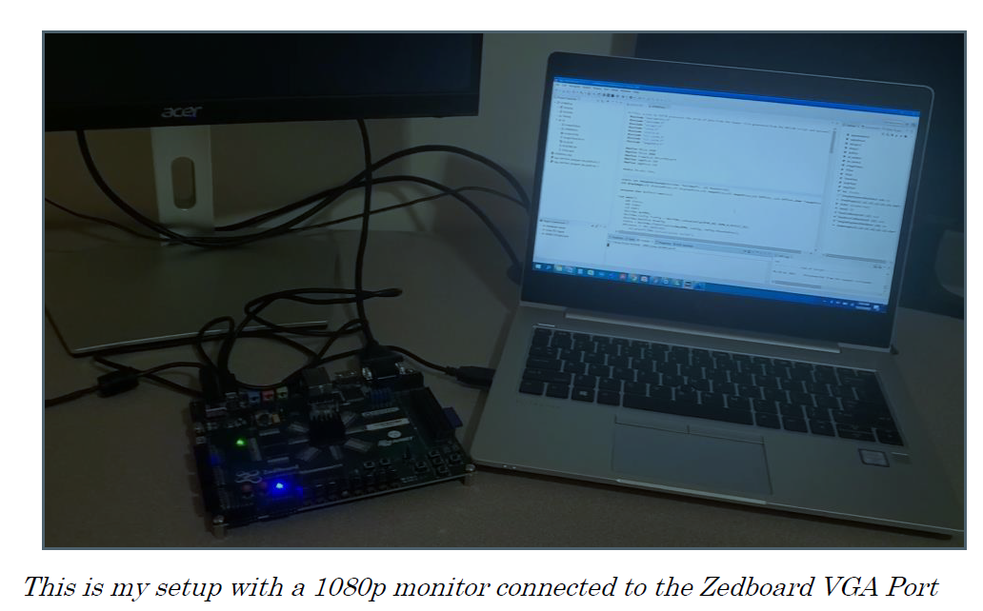
Results

Slide 13
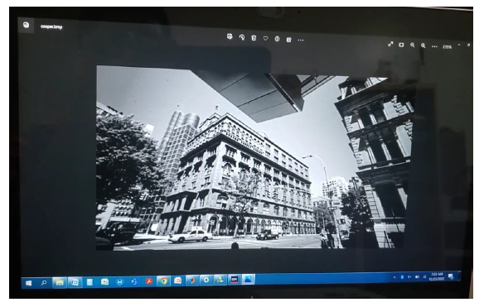
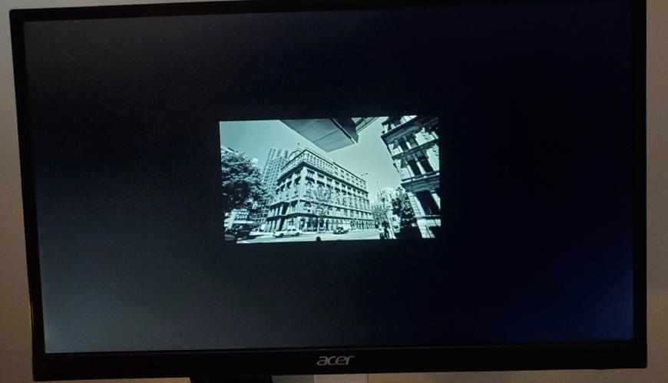
Results
Original Image (318x565)
Image on 1080p Monitor

